Slide 2
What‘s new in RequestsLibrary 0.9
Luca Giovenzana – Head of Agile Delivery at CHILI

Slide 3

Once upon a time

Slide 4

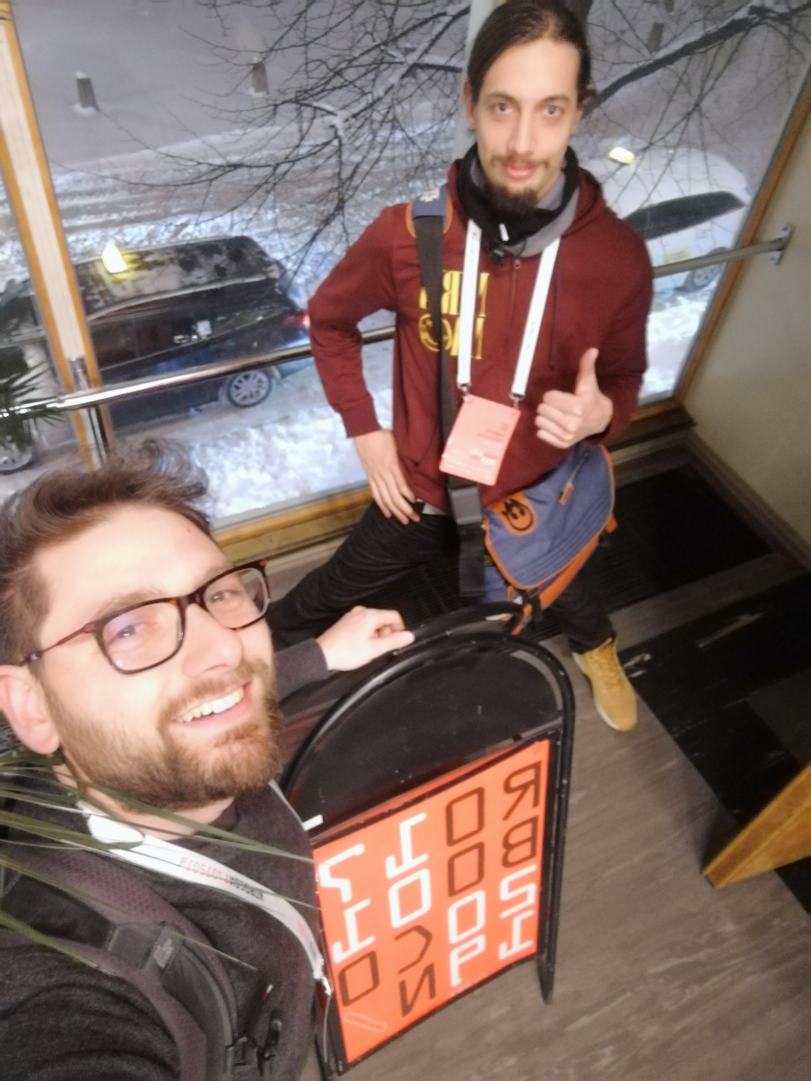
Requests session hacking

Slide 5
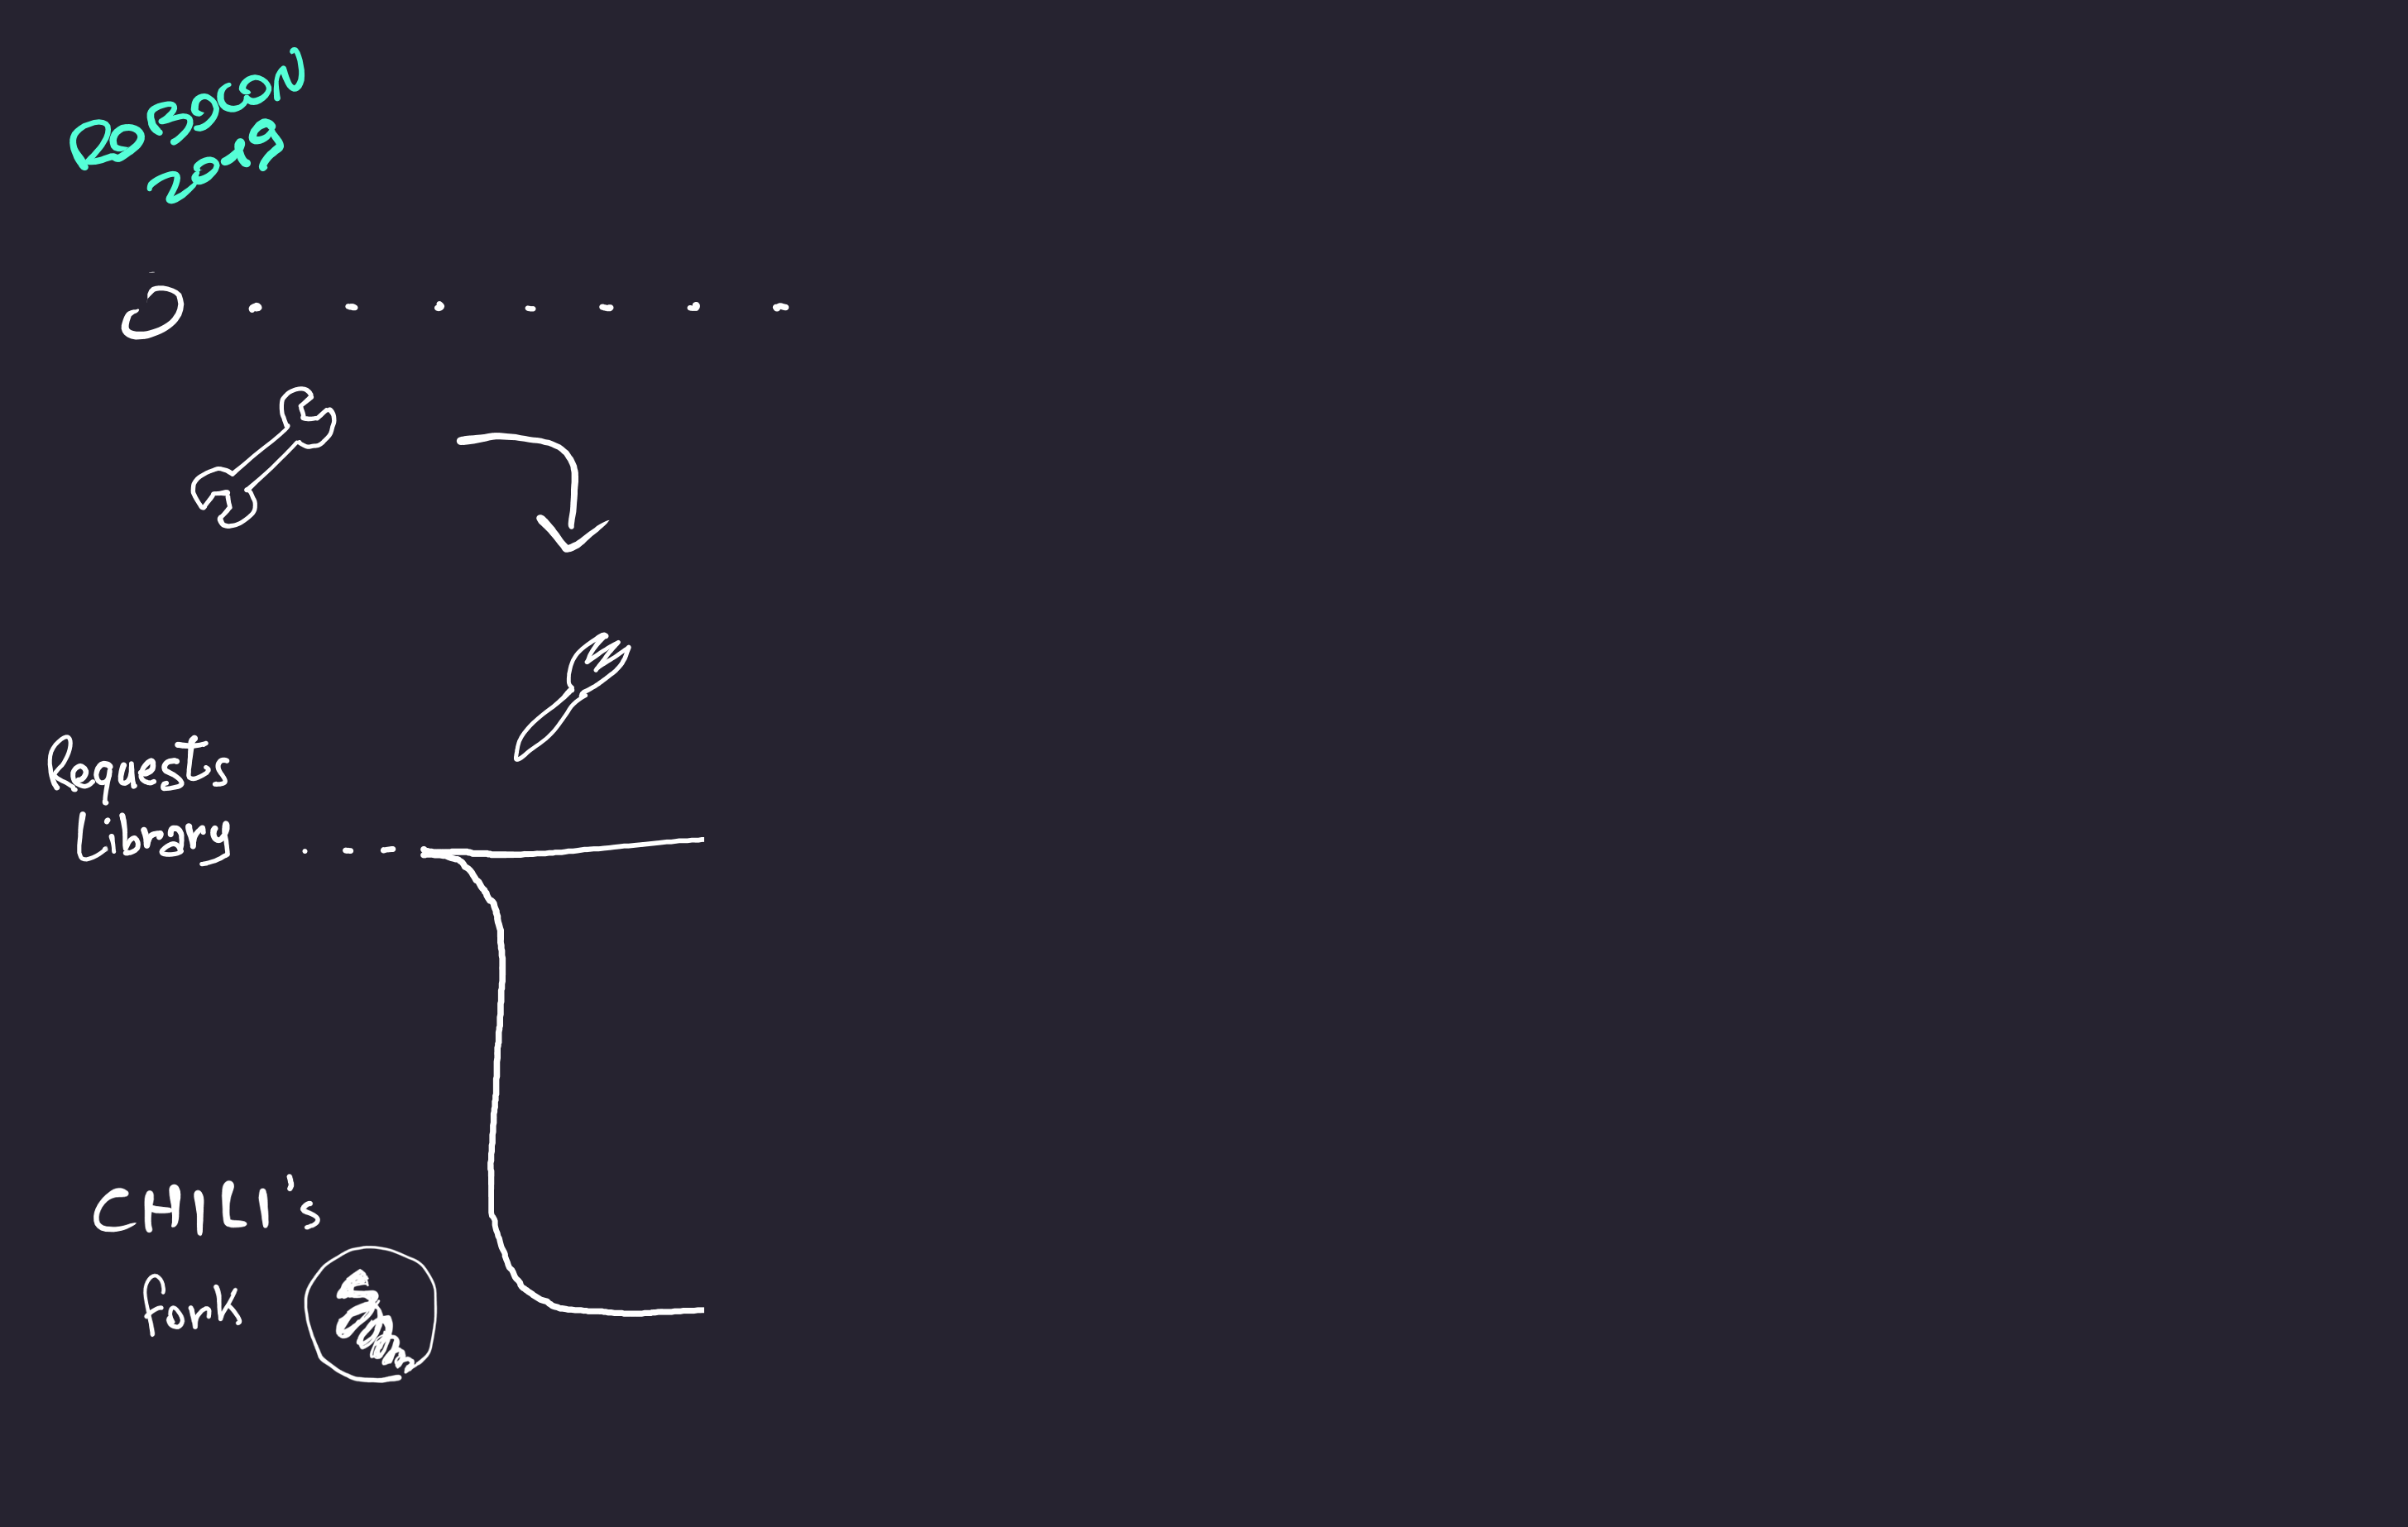
Needed to fork

Slide 6
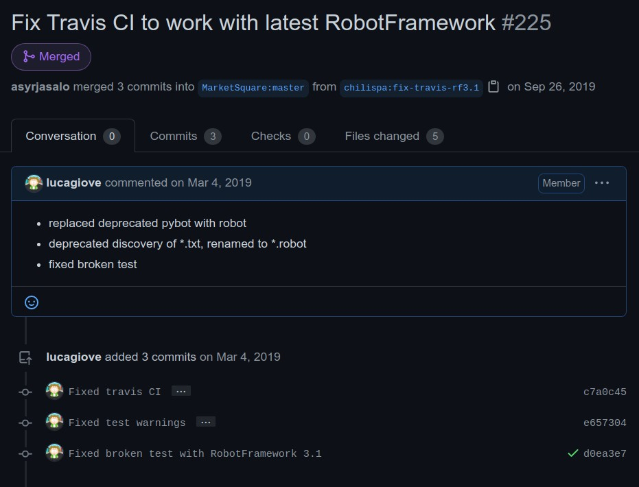
First pull request

Slide 7
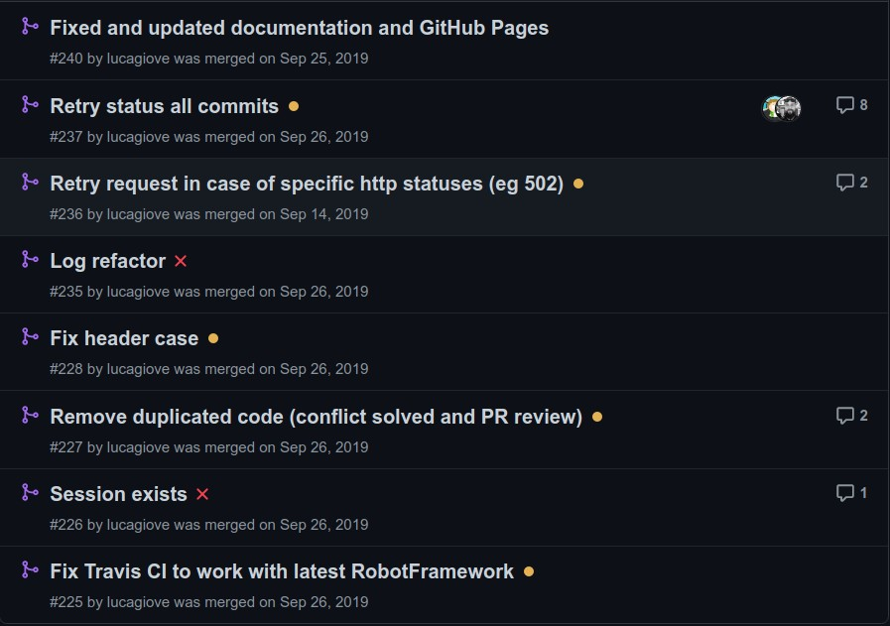
Multiple pull requests

Slide 8
Finally merged

Slide 9
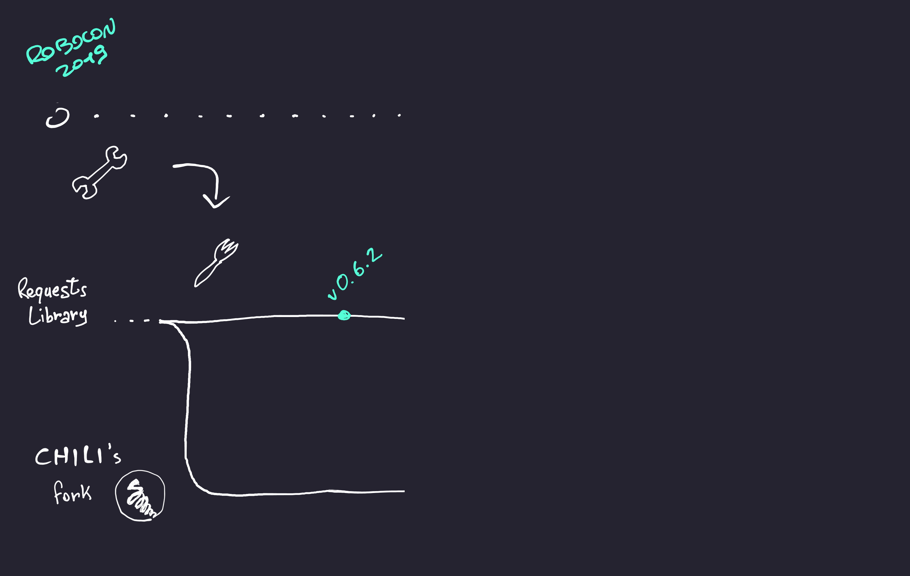
First release: fixes and retry

Slide 10
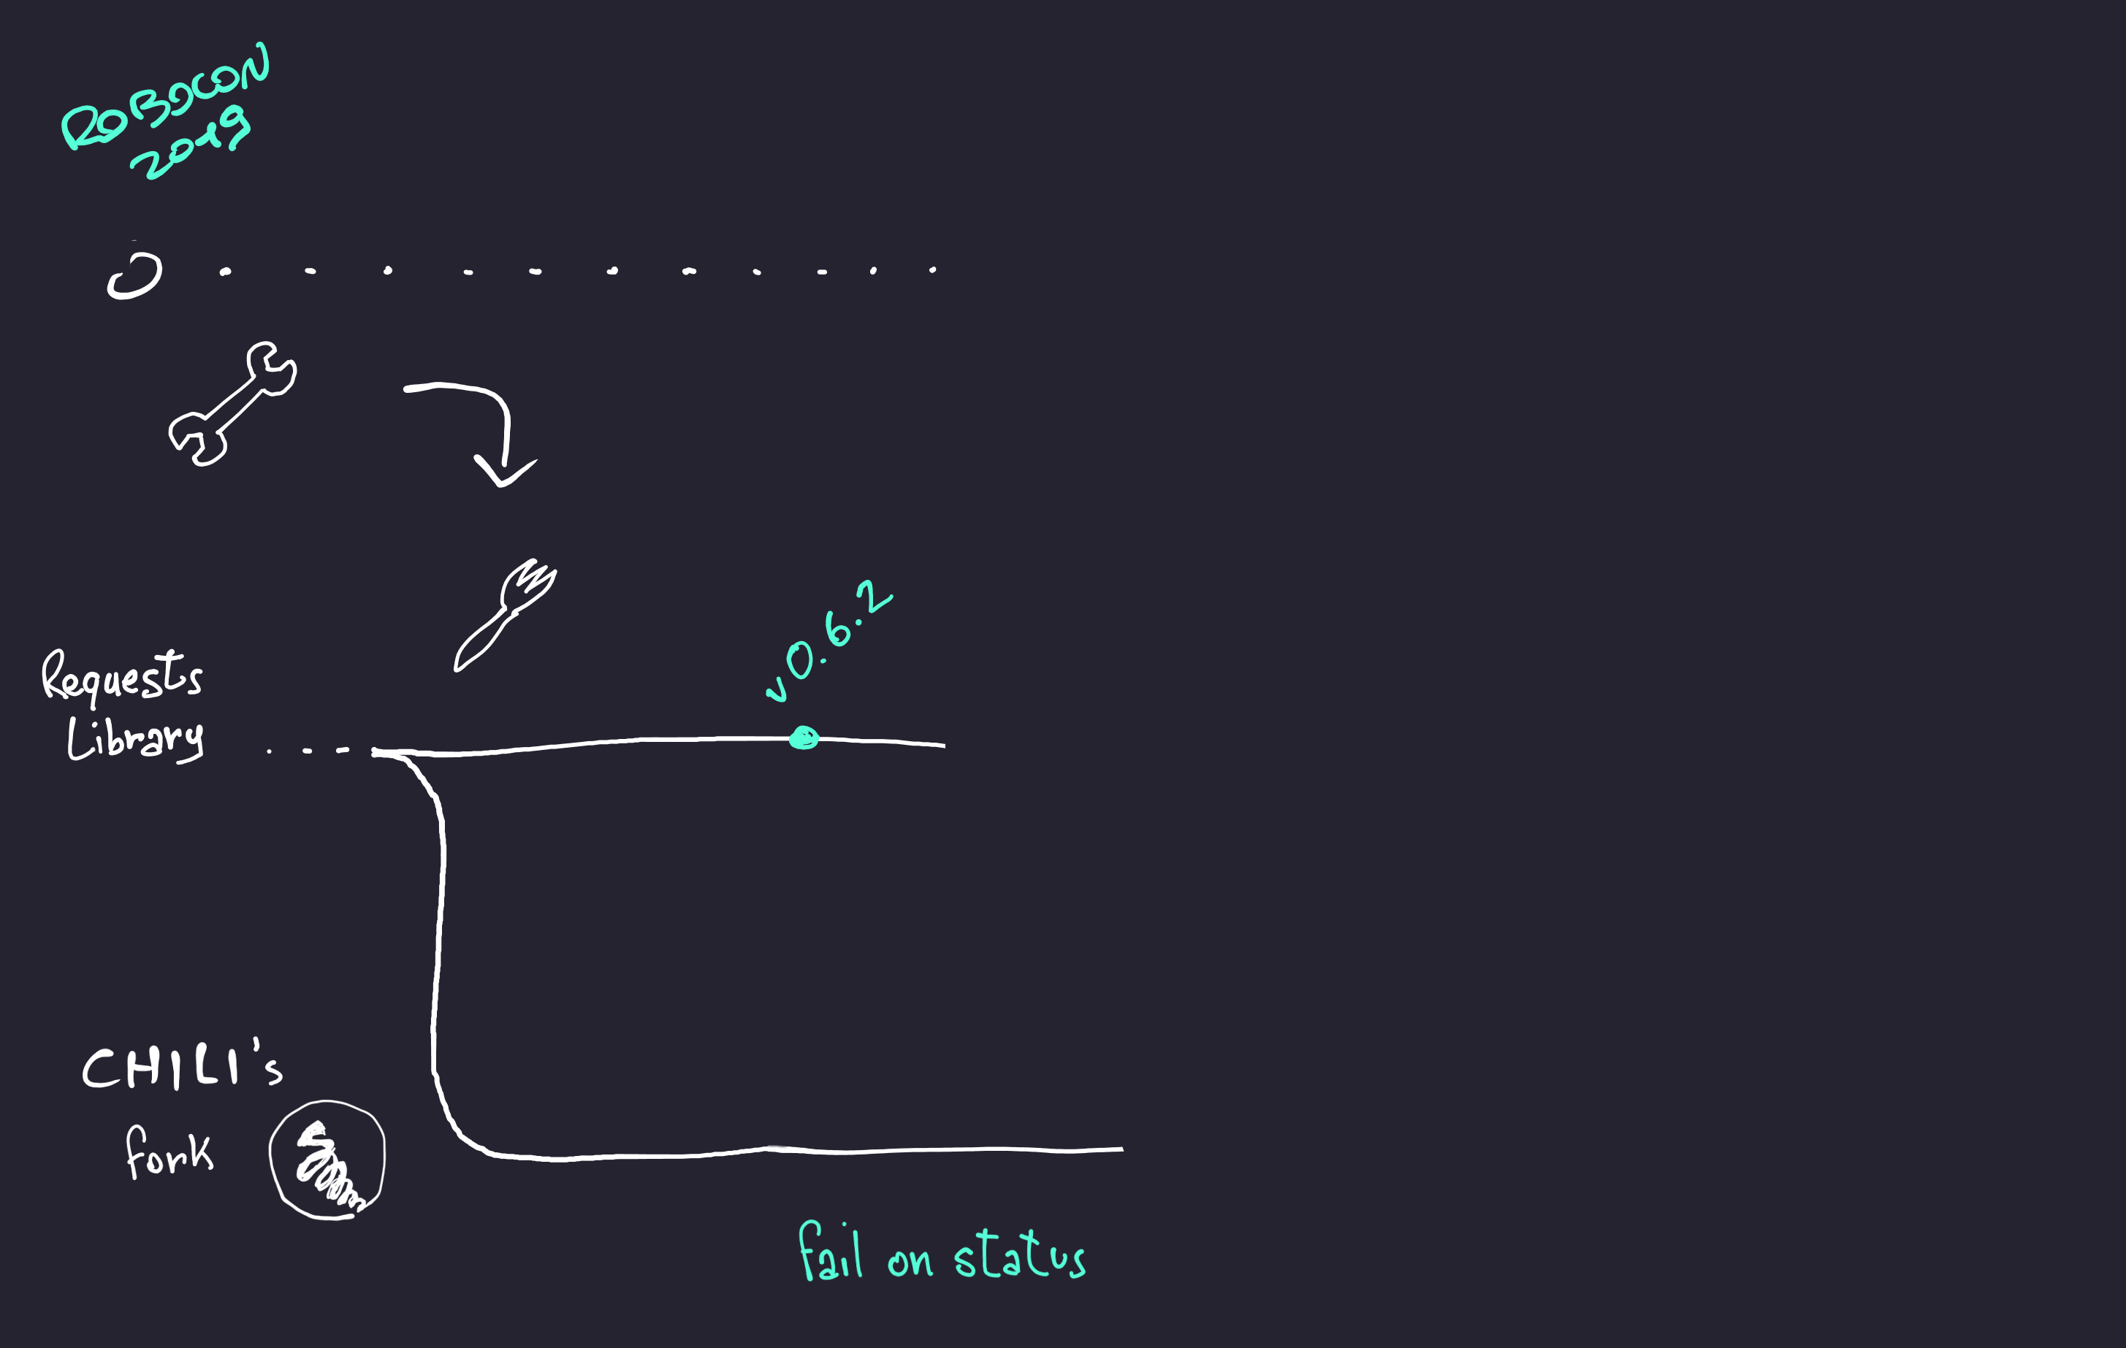
Fail on error

Slide 11
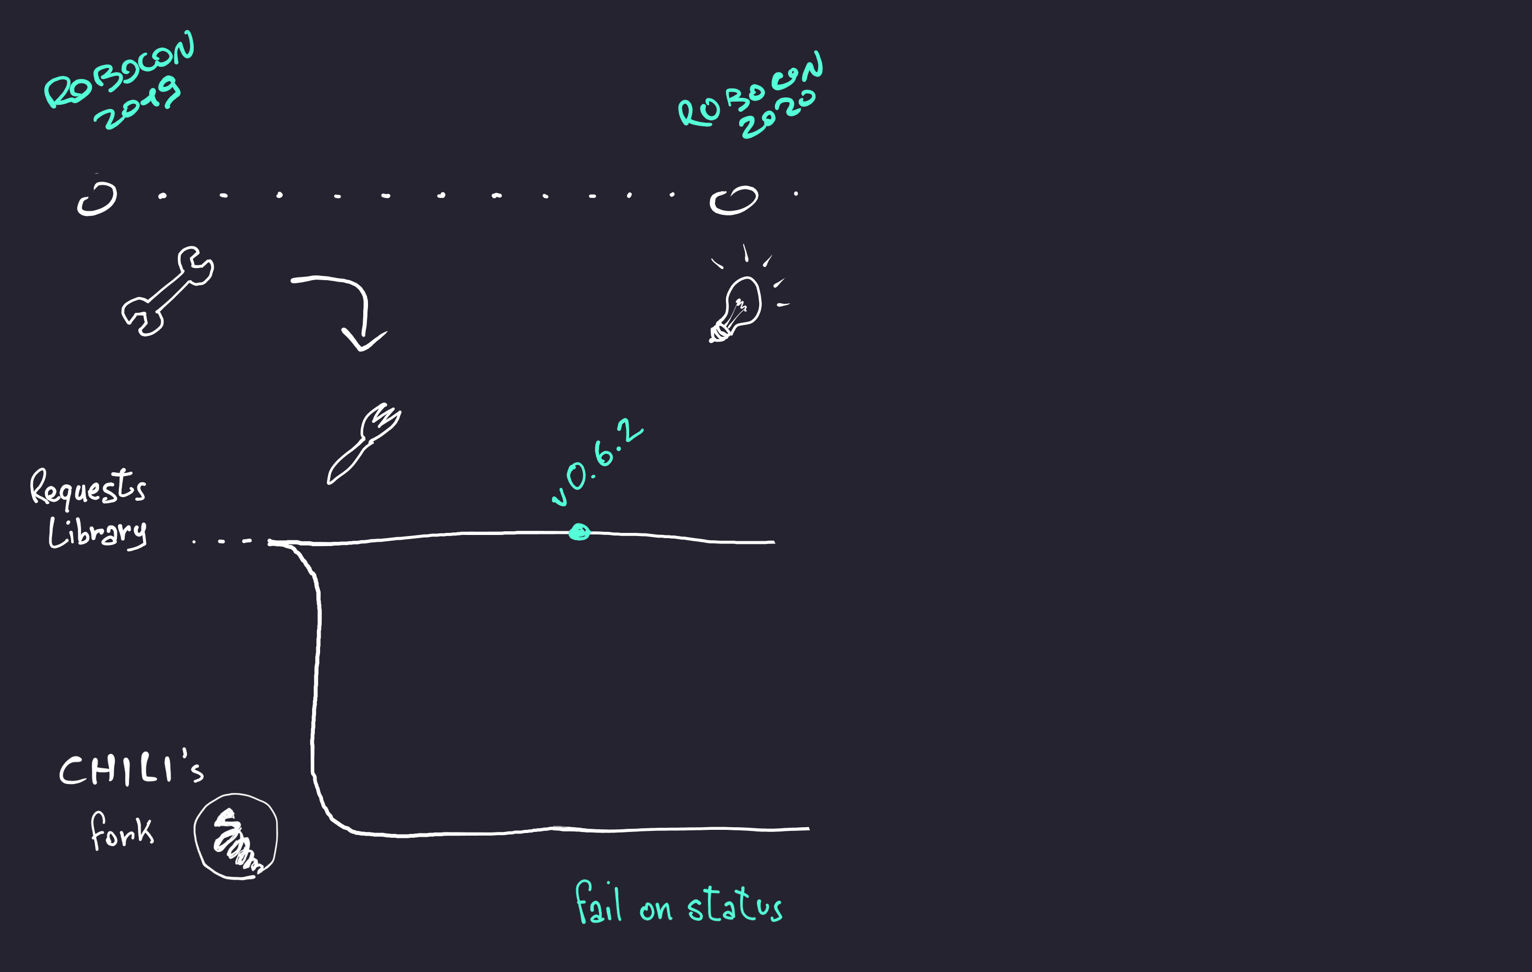
Robocon 2020: talks and ideas

Slide 12
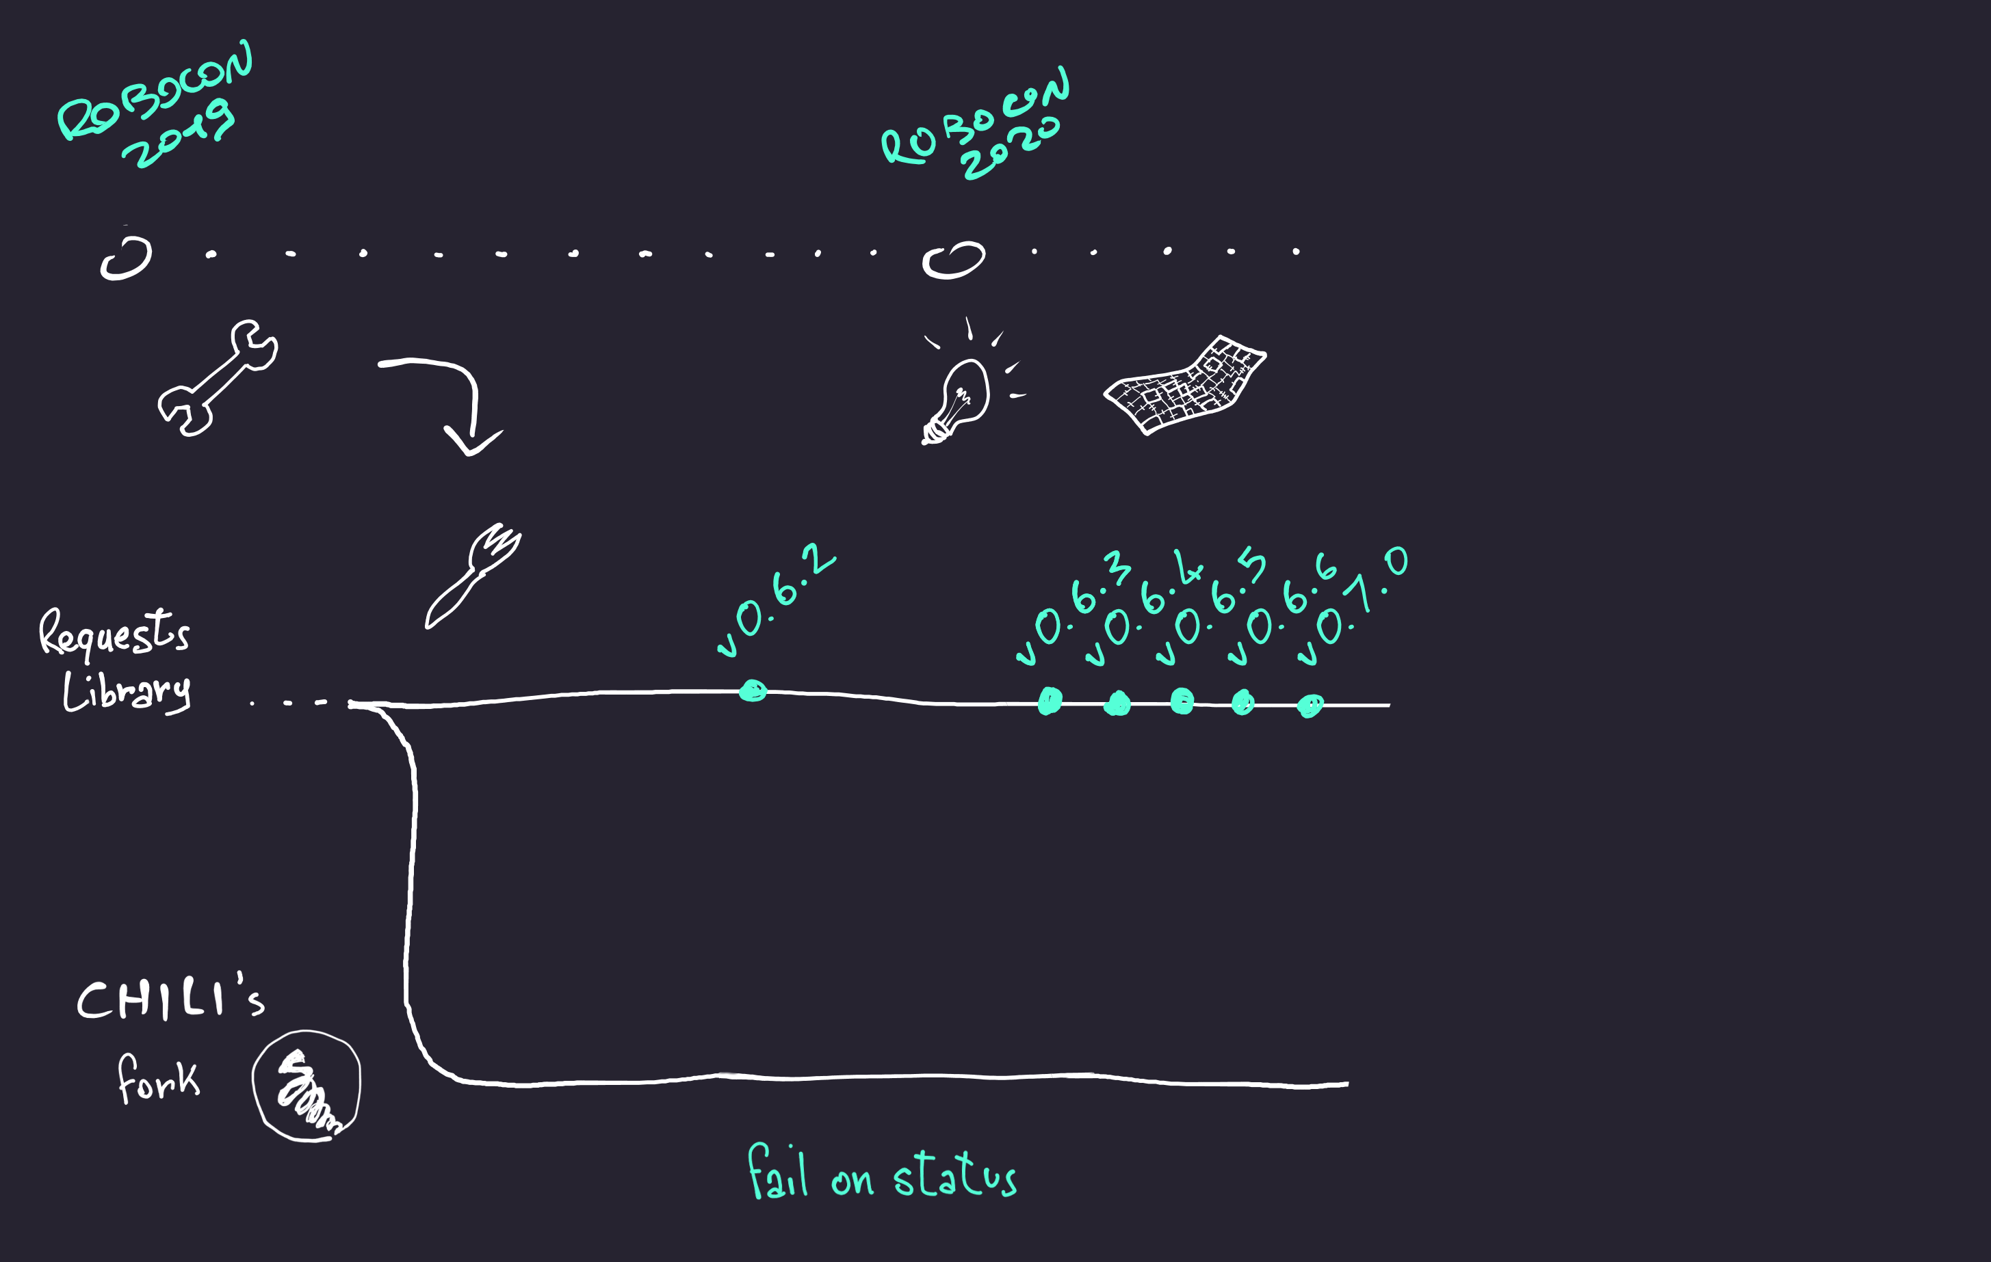
Code was a patchwork

Slide 13
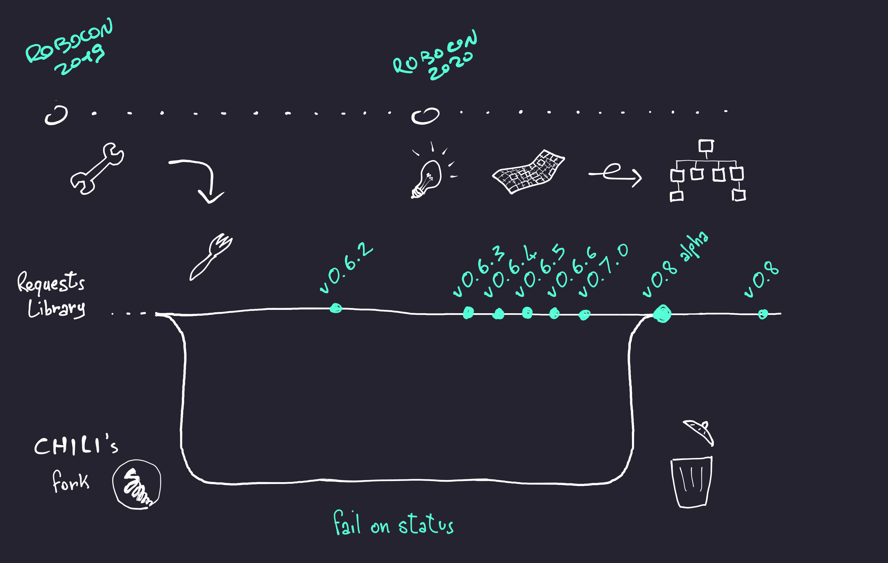
Radical approach: new kwords structure

Slide 14
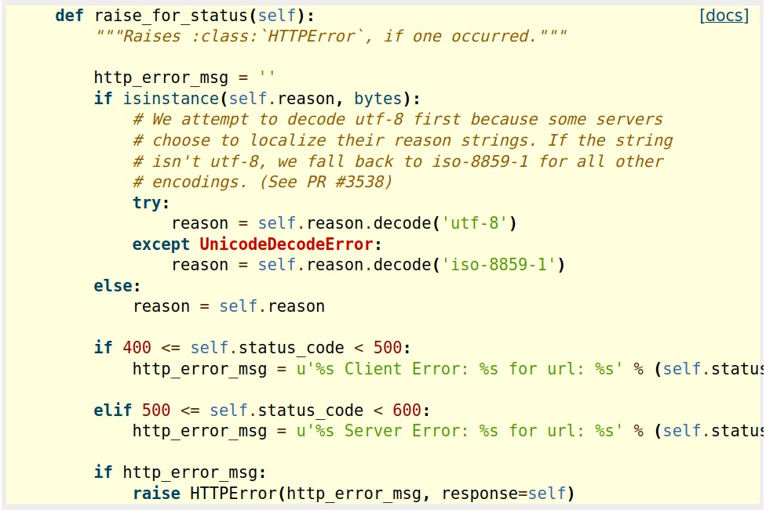
Implicit assert

Slide 15
Best practices and common pitfalls
Embed requests in nested keywords
see an example
Positional url with = symbol (ex. /endpoint?sort=asc) will fail because of RobotFramework handling with kwargs**
String as arguments or missing spaces

Slide 16
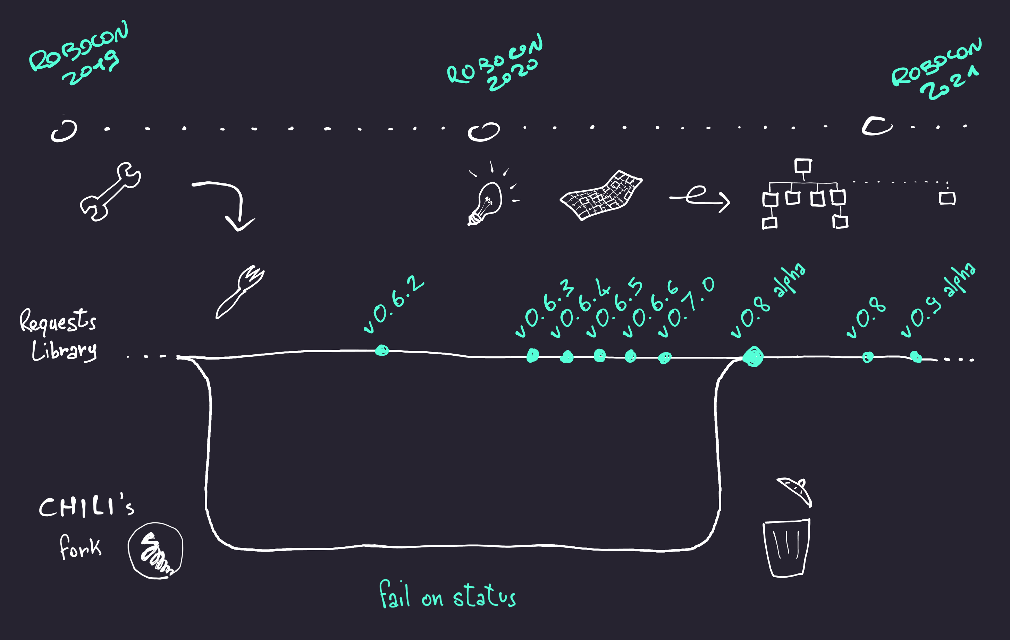
Upcoming 0.9 version, readme

